Slide 1
Resource Allocation for Enhanced QoS in 5G Networks using Advanced Reinforcement Learning and Graph Neural Networks
Team Members:
21I302 Akash K
21I311 Dharunraj A
21I315 Elamurugan RM
21I331 Midhun Ramanujam S
Project Guide
Dr. Anitha Kumari K
Associate Professor
Department of Information Technology
PSG College of Technology
Coimbatore.

Slide 2
Agenda: -
Introduction
Objective
Scope of the Project
Literature Survey
Drawbacks of existing system
Proposed Methodology
Dataset
Block Diagram
Model and Algorithms
Requirements
Timeline
References

Slide 3
Introduction: -
Challenges in current 5G resource allocation:
One of the key challenges with 5G is improper resource optimization. As the technology demands higher data rates and more reliable connections, managing the allocation of network resources effectively becomes critical.
Inefficient use of these resources can lead to issues such as network congestion, increased latency, and reduced overall performance, affecting the quality of service for end users.
Solution:
To solve this, Advanced Reinforcement Learning (RL) techniques are applied.
These Techniques include Q-Learning, Deep Q-Networks (DQN), Deep Deterministic Policy Gradient (DDPG).
State representation to these techniques are defined by application type, signal strength, latency, required bandwidth, allocated bandwidth and resource allocation.

Slide 4
Objective of the Project: -
Algorithms Implementations: Implement RL techniques (Q-Learning, DQN, DDPG) and integrate GNNs for bandwidth optimization.
Define States & Actions: Establish parameters for network states and bandwidth adjustments.
Measure Performance: Evaluation of performance will be done using episodic reward, cumulative reward, average reward, and mean bandwidth difference, and metrics MAE, MSE, RMSE, MAPE, R-squared, F1 score.
Integration: GNN to provide state representation to RL techniques, combining these two modules into a unified system.

Slide 5
Scope of the Project: -
Optimize Bandwidth Allocation: Use RL techniques to dynamically adjust bandwidth based on network conditions.
Enhance Quality of Service (QoS): Improve overall service quality by ensuring optimal resource allocation.
Reduce Resource Wastage: Ensure efficient utilization of network resources to minimize wastage.
Adapt to User Demands: Automatically adjust resource allocation based on varying user demands and application requirements.
Improve Decision-Making: GNN and RL techniques for more accuracy and timely decisions regarding resource allocation.

Slide 6
Literature Survey: -
S.No | Title and Authors of the paper | Publication Year and Conference | Inferences | Drawbacks
1. | Reinforcement learning for dynamic resource optimization in 5G radio access network slicing. Shi, Yi, Yalin E. Sagduyu, and Tugba Erpek. | 2020 IEEE 25th international workshop on CAMAD. IEEE, 2020. | The proposed methodology focuses on adjusting the allocated bandwidth to ensure efficient and effective resource utilization. Also maintaining low latency and good signal quality for various applications. | The proposed methodology focuses on single-parameter optimization, specifically on bandwidth allocation, without considering other parameters.
2. | ML-Based Radio Resource Management in 5G and Beyond Networks: A Survey | IEEE Access, vol. 10, pp. 83507-83528, 2022. | The paper highlights ML's effectiveness in throughput prediction and identifies issues like data quality and computational complexity. Offers guidelines for future research to improve ML-based RRM and enhance quality of service (QoS) in 5G/B5G networks. | No significant drawbacks are found in the paper.

Slide 7
Cont’d: -
3. | Effective resource allocation technique to improve QoS in 5G wireless network. Jayaraman, Ramkumar, et al. | Electronics 12.2 (2023): 451. | The proposed methodology offers a significant advancement in resource allocation for CRAN systems by leveraging machine learning techniques to improve prediction accuracy, network throughput, and energy efficiency. It addresses limitations of traditional CSI-based methods and provides a robust solution for managing high-density networks, though further optimization may be needed for extremely high user loads. | The proposed methodology does not provide a dynamic approach that continuously adjusts to evolving network conditions and user demands.
4. | Resource management in 5G mobile networks: Survey and challenges. Chien, Wei-Che, et al. | Journal of Information Processing Systems 16.4 (2020): 896-914. | The study underscores the inadequacy of traditional network approaches for modern applications and emphasizes the need for advanced resource management strategies. Also shows network slicing and MEC are pivotal for future research and development. | No significant drawbacks are found in the paper.

Slide 8
Cont’d: -
5. | A comprehensive survey on radio resource management in 5G HetNets: Current solutions, future trends and open issues. Agarwal, Bharat, et al. | IEEE Communications Surveys & Tutorials 24.4 (2022): 2495-2534. | The paper surveys RRM techniques for 5G HetNets, addressing interference and resource allocation challenges. It categorizes methods into interference management, user association-resource-power allocation, and combined approaches, and outlines future research directions. | No significant drawbacks are found in the paper.
6. | Optimal 5G network slicing using machine learning and deep learning concepts. Abidi, Mustufa Haider, et al. | Computer Standards & Interfaces 76 (2021): 103518. | The paper proposes an efficient 5G network slicing model using a hybrid learning algorithm. It optimizes feature extraction with GS-DHOA and classifies network slices using a hybrid of deep belief networks and neural networks. Improves slicing accuracy and efficiency for diverse 5G applications. | The proposed method lacks adaptability, scalability, and real-time decision-making capabilities. It is not well-suited for complex and dynamic 5G network environments. #

Slide 9
Cont’d: -
7. | Reinforcement learning based resource management for network slicing. Kim, Yohan, Sunyong Kim, and Hyuk Lim. | Applied Sciences 9.11(2019) | The paper proposes network slicing in 5G networks to enable creation of virtual networks that are tailored to diverse service requirements. To address the inefficiencies, a dynamic resource management system based on Q-learning is proposed.. Simulations validate the effectiveness in improving the overall network performance in real world scenarios. | Real World performance was not verified
8. | Multi-UAV cooperative task offloading and resource allocation in 5G advanced and beyond. Guo, Hongzhi, et al | IEEE Transactions on Wireless Communications 23.1(2023) | The paper proposes a software-defined networking enhanced cooperative multiple UAV-enabled aerial computing (MUEAC) system. Aims to minimize task processing delays by optimizing task scheduling, resource allocation and data dependencies. A multi-UAV cooperative communication and computing optimization (MCCCO) scheme is proposed. Results validate that MCCCO outperforms traditional schemes. | SDNs and UAVs can be very complex and hard to deploy, also has scalability issues.

Slide 10
Cont’d: -
9. | Handover and load balancing self-optimization models in 5G mobile networks Saad, Wasan Kadhim, et al. | EngineeringScience and Technology, an International Journal.(2023) | The paper discusses a QoS-based resource allocation scheme using OFDM-based interface for device to device (D2D) within cellular networks, allowing flexible allocation of the resources. The results of the paper validate the effectiveness of the proposed methodology while also accommodating service flexibility. | Scalability remains a problem, as the number scaling QoS poses a significant challenge.
10. | Smart load-based resource optimization model to enhance the performance of device-to-device communication in 5G-WPAN. Logeshwaran, Jaganathan, et al | Journal: Electronics 12.8 Year: 2023 | The paper discusses various optimization techniques for device-to-device (D2D) communication in wireless networks. Focuses on resource allocation strategies including dynamic allocation of bandwidth and resources and load balancing. The proposed load based resource optimization model is shown to achieve 86% network efficiency and 91.94% reduced latency. | While the tests are done via simulation, the results are yet to be validated in real world scenarios.

Slide 11
Drawbacks of existing system: -
Scalability concerns: They are not efficient for complex and dynamic environment.
No actions are taken based on previous state information .
Low Adaptability: They are less adaptable in dynamic approach that continuously adjusts to evolving network conditions and user demands.
Handling of unseen data: Traditional system can’t able to handle the unseen data or outliers efficiently.

Slide 12
Proposed Methodology: -
This project leverages reinforcement learning (RL) and Graph Neural Networks (GNNs) to dynamically manage network resources for enhanced QoS.
The proposed system aims to optimize Bandwidth based on key network parameters.
RL framework represent the state of the system is represented by a combination of Application Type, Signal Strength, Latency, Required Bandwidth, Allocated Bandwidth and Resource Allocation.
Actions involve increase, decrease or maintain the allocated bandwidth.

Slide 13
Contd’: -
The reward function is designed to reflect the quality of actions made by the model for the given state.
The approach evaluates RL algorithms, including Q-Learning, DDGP and DQN Methods. The agent is trained over multiple episodes, interacting with the environment to learn and improve its policy based on rewards.
The Graph Neural Network is integrated to capture similarity, spatial and temporal dependencies in the network, enhancing the learning process and resource allocation decisions.

Slide 14
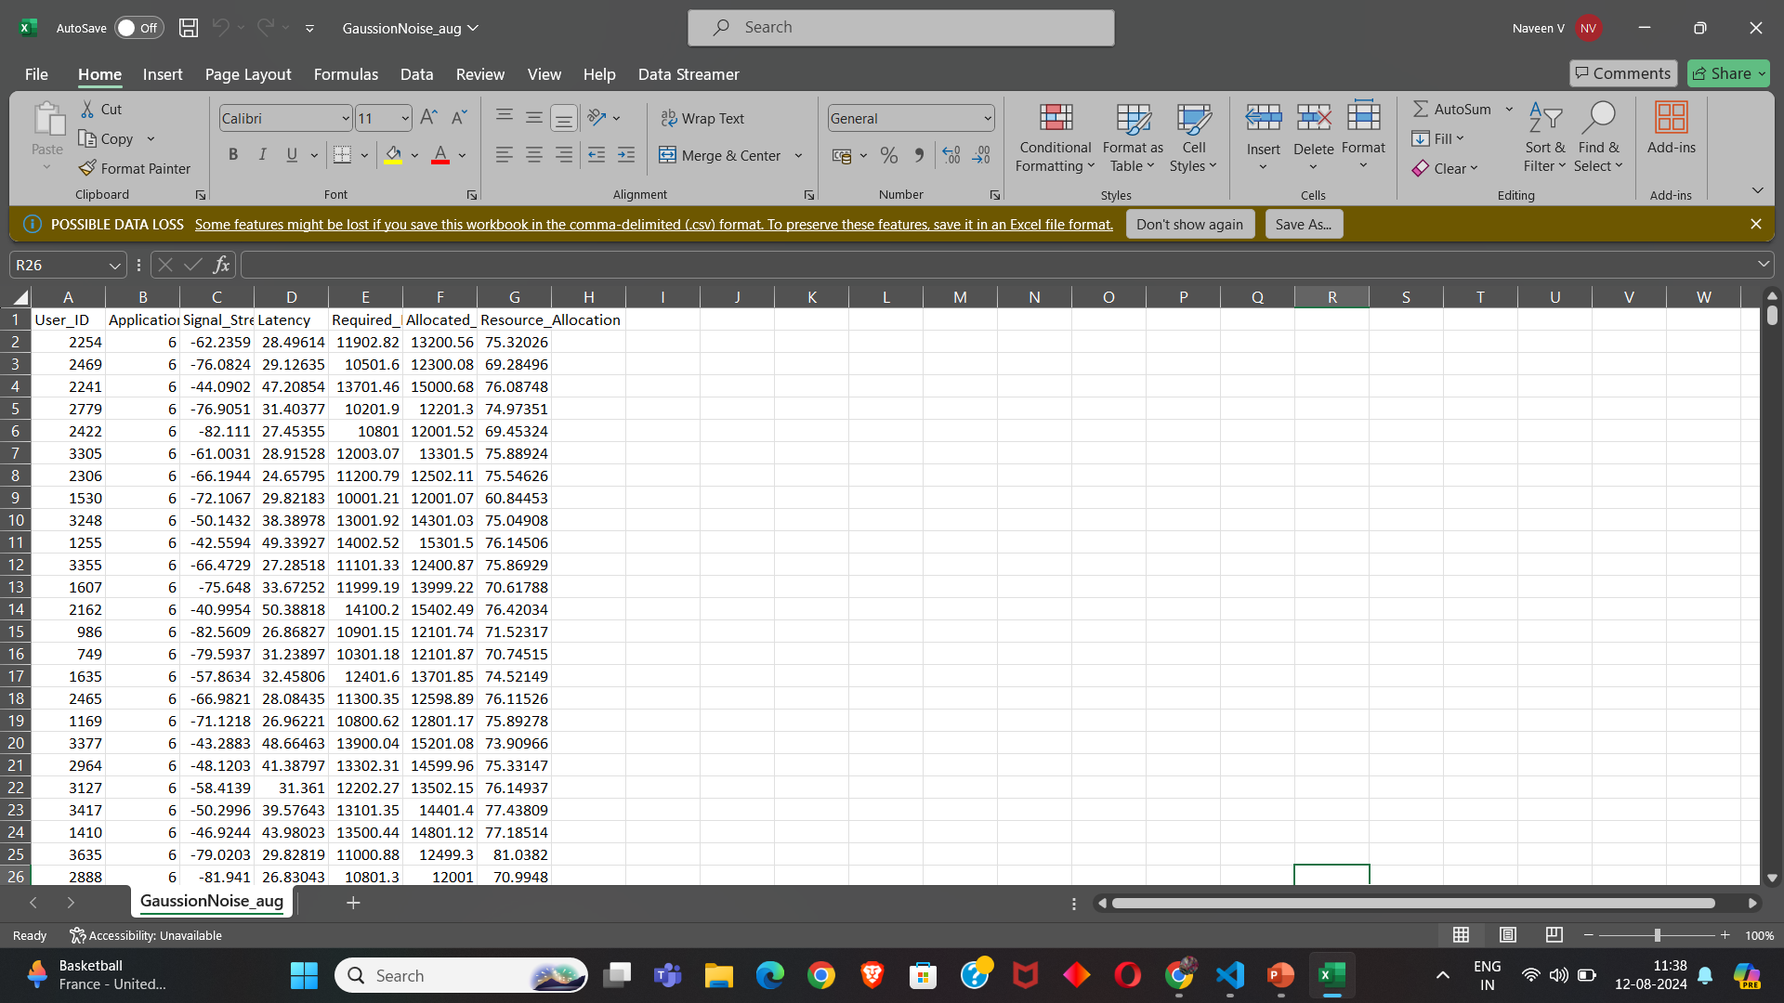
Dataset: -
Git repo:
https://github.com/Elamurugan-RM/5G_Resource_Allocation_GNN_RL/blob/main/Dataset/augmented_dataset.csv
FEATURES :
Signal strength: -90 dBm to -30 dBm
Latency: 0 ms to 100 ms (realtime: 20 ms to 30 ms)
Allocated Bandwidth: 0 Kbps to 100000 Kbps (exact or slightly exceed bandwidth allocation, not lesser or over-provisioning)
Required Bandwidth: 0 Kbps to 100000 Kbps
(Varies by application)
Resource Allocation: 0 % to 100 %
(Efficiency of allocated resource)
Application Type: (Label Encoded mapping)
Background_Download
Emergency_Service
File_Download
Iot_Temperature
Online_Gaming
Streaming
Video_Call
Video_Streaming
Voice_Call
VoIP_Call
Web_Browsing

Slide 15
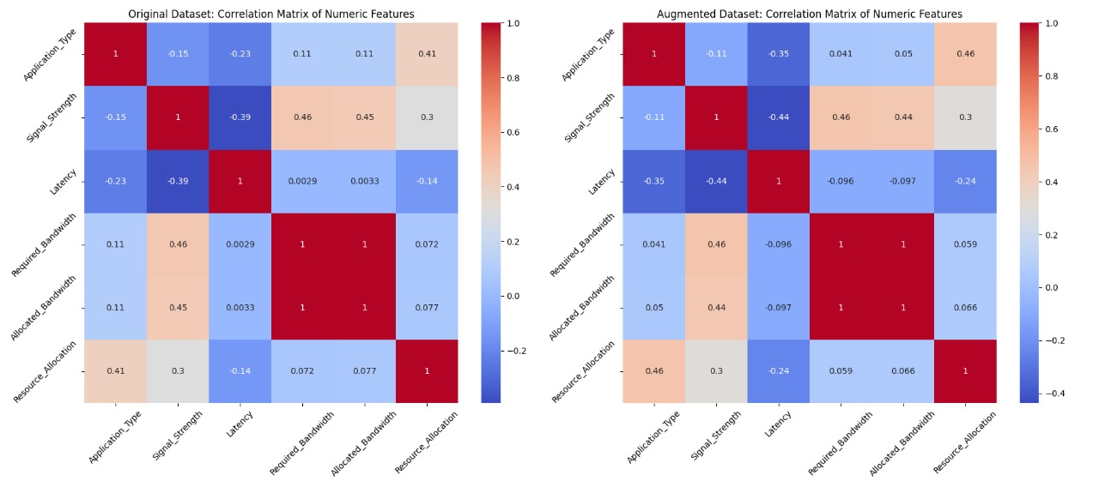
Dataset Augmentation (Gaussian Noise): -
Original dataset size: 400 objects
Augmented dataset size: 20400 objects
Inference:
Gaussian Noise augmented data has higher correlation with the original dataset compared to other techniques such as Random Oversampling, MLP, SMOGN.

Slide 16
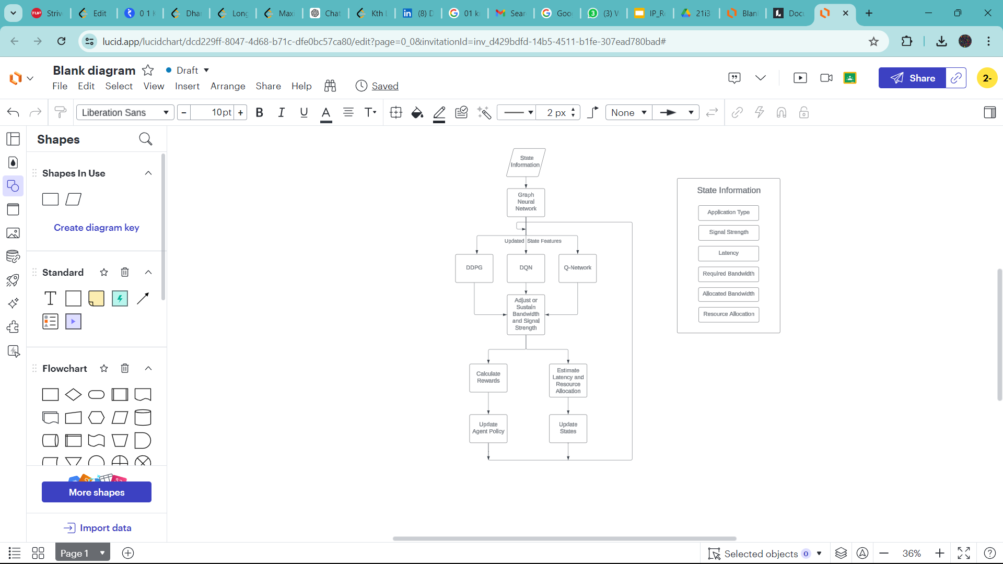
Block diagram: -

Slide 17
Graph Neural Network Algorithm
Graph representation:
Nodes (V): Represent entities, each with associated features (represent a user or application type with features application_type, like signal strength, latency, required_BW, allocated _BW, resource allocation).
Edges (E): Represent connections or relationships between nodes
Adjacency Matrix (A): A square matrix used to represent the graph, where each element A(i,j) indicates the presence of an edge between node i and node j.
Feature Matrix (X): A matrix where each row corresponds to a node, and columns represent the features of that node.
Message Passing Mechanism
Aggregation: Each node aggregates information from its neighbors. This is done by summing, averaging, or applying a more complex function to the features of neighboring nodes.
Update: The node’s own features are updated using the aggregated information. This is where learnable parameters (weights) are applied, through a neural network layer a fully connected (dense) layer.
Propagation: The updated node features are then passed to the next layer of the GNN for further processing.

Slide 18
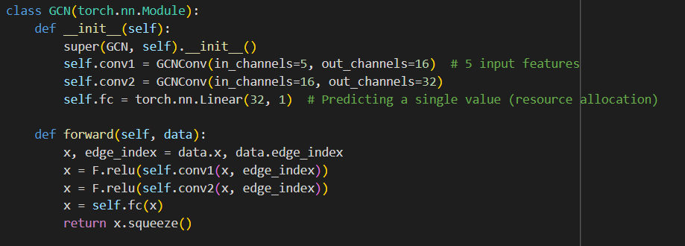
GNN Algorithm
Layers in the GCN:
Input Layer: Takes the node features matrix X and the adjacency matrix A
conv1: A graph convolutional layer with 5 input features and 32 output features.
conv2: A second graph convolutional layer, which takes the 32 output features from conv1 and outputs 64
features.fc: A fully connected (linear) layer that takes the 64 output features from conv2 and produces a single value, which represents the predicted resource allocation.

Slide 19
GNN Algorithm
Forward Pass:
The forward method takes a data object, which contains the node features (data.x) and the graph's edge connections (data.edge_index).
The node features x are passed through the first graph convolutional layer conv1, along with the graph's edge information edge_index.
The output is passed through a ReLU activation function (F.relu), introducing non-linearity.
The transformed features are then passed through the second graph convolutional layer conv2, again followed by a ReLU activation.
The output of the second graph convolutional layer is fed into a fully connected layer (fc) to produce the final predicted value for each node.
Backpropagation and Optimization
Loss Calculation: The predicted values are compared to the Actual values using a loss function mean squared error is used to determine the loss in regression task.
Gradient Calculation: Gradients of the loss with respect to the model parameters are computed.
Parameter Update: Using ADAM optimizer the model parameters are updated to minimize the loss.
Learning rate is fixed as “0.01”

Slide 20
Graph Neural Network : -
Graph Network is created using Networkx library from the Augmented_dataset.
Three types of graph network model has been created.
Spatial graph, Similarity graph , Application graph.
Each graph is trained using GNN and evaluated through metrics such as
MAE
MSE
RMSE
MAPE
R-squared
F1 Score

Slide 21
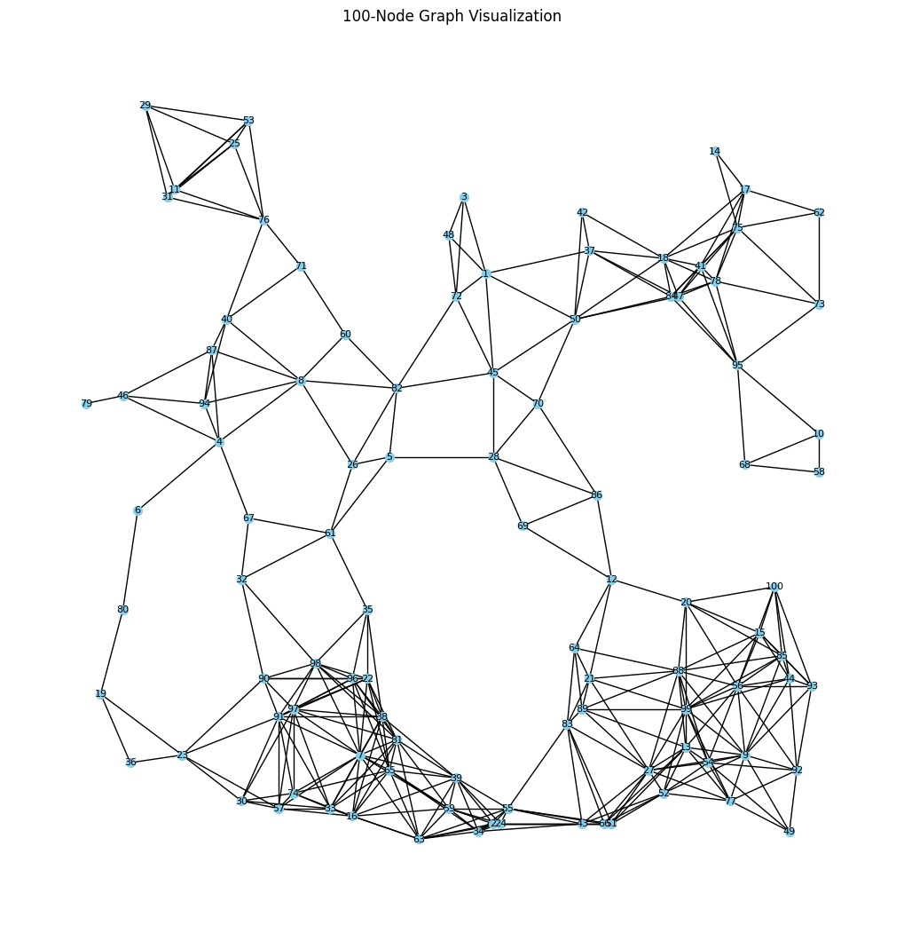
Spatial Graph : -
Spatial coordinates are used in the augmented dataset
100 X 100 units coverage area defined.
Each node is connected to the nodes that are located below the threshold of 15 units.
Euclidean distance measure is used to calculate the distance between a pair of node.
Graph network is created with node embeddings of size 7
Trained over GNN model to predict the Resource Allocation.

Slide 22
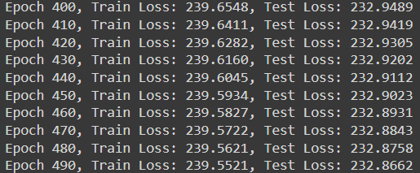
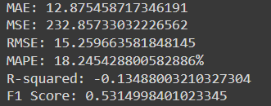
Spatial Graph Result Analysis

Slide 23
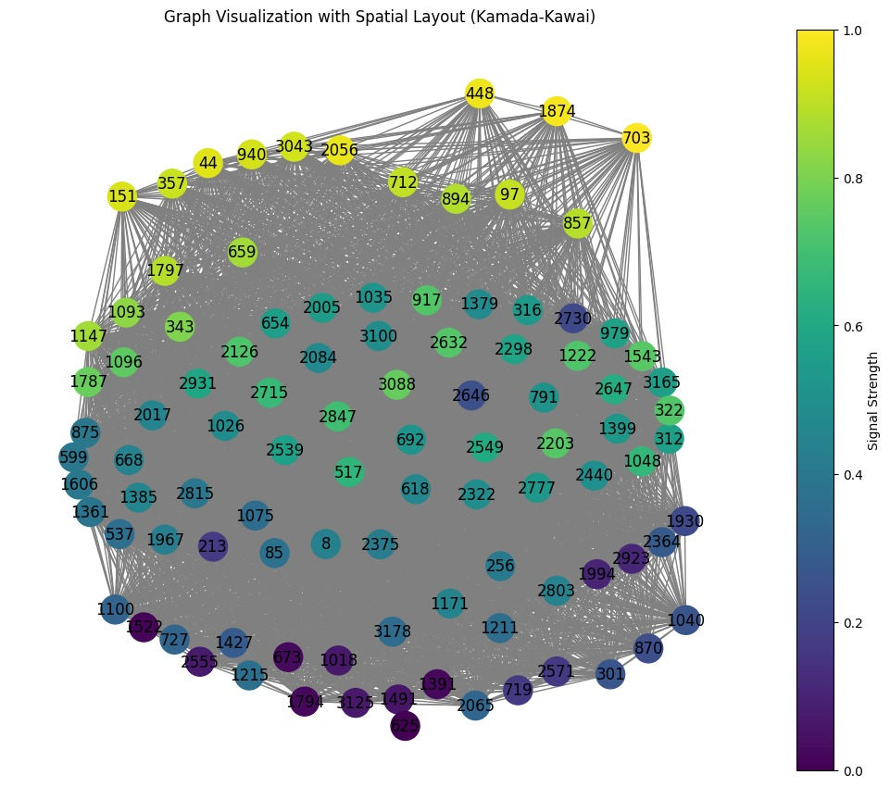
Similarity based Graph: -
Similarity Based graph was created using the features Required Bandwidth and Allocated Bandwidth
Euclidean Distance was calculated between the nodes for this Graph.
Threshold for the edge creation was based on the Percentile Measure of 90
Graph network was created using the network library which contains node with 5 embeddings.
GNN was defined to take the graph input and predict the Resource allocation.
Trained and tested over the Augmented dataset.

Slide 24
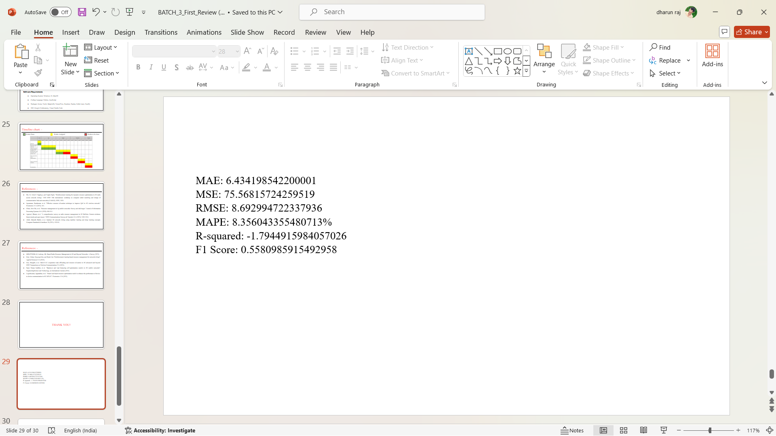
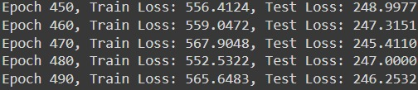
Similarity Graph Result Analysis

Slide 25
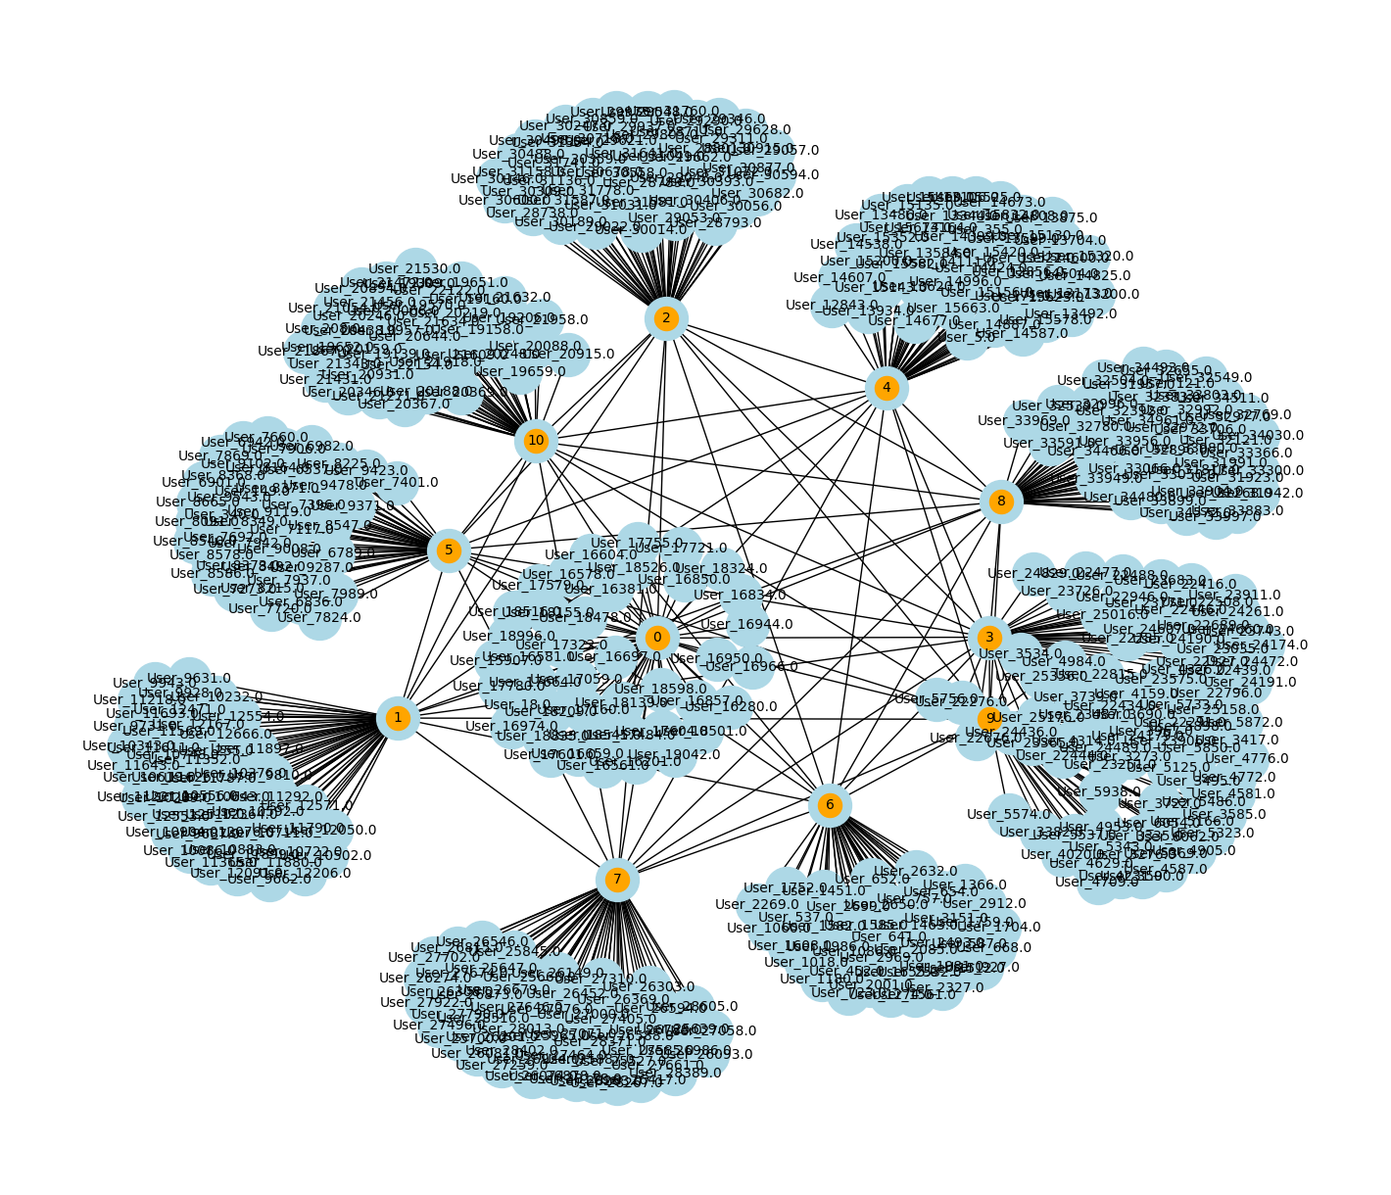
Application based Graph: -
Each Application unique application is created as a node known as application node.
Each user node is taken and analyzed for the application type and then connected to the respective application node.
Applications node are connected to the other application node.
GNN was defined to take the graph input with node embeddings and predict the Resource allocation.
Trained and tested over the Augmented dataset.

Slide 26
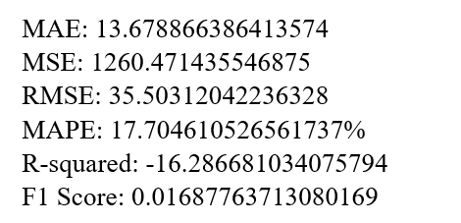
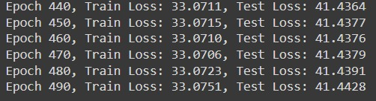
Application Graph Result Analysis

Slide 27
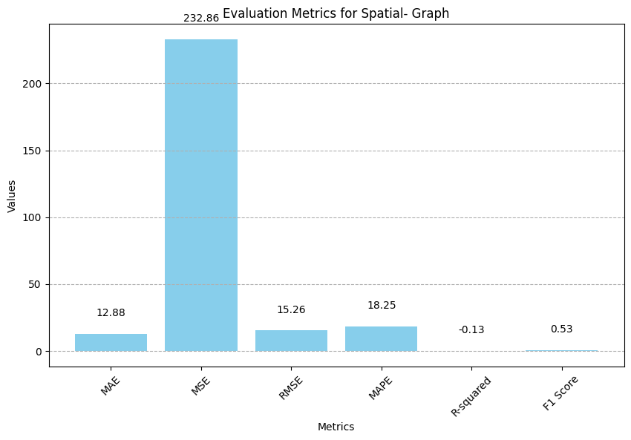
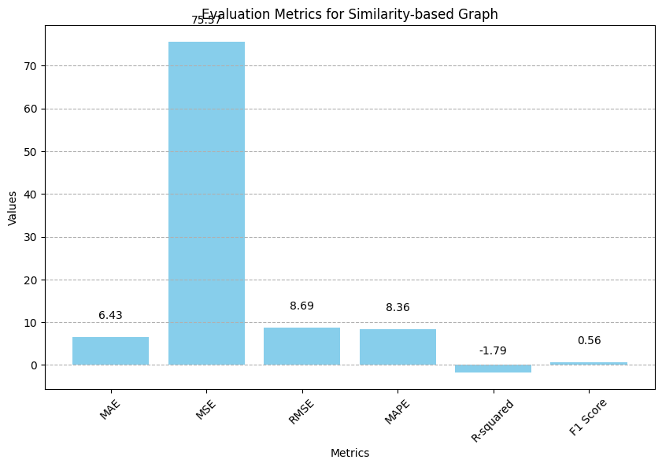
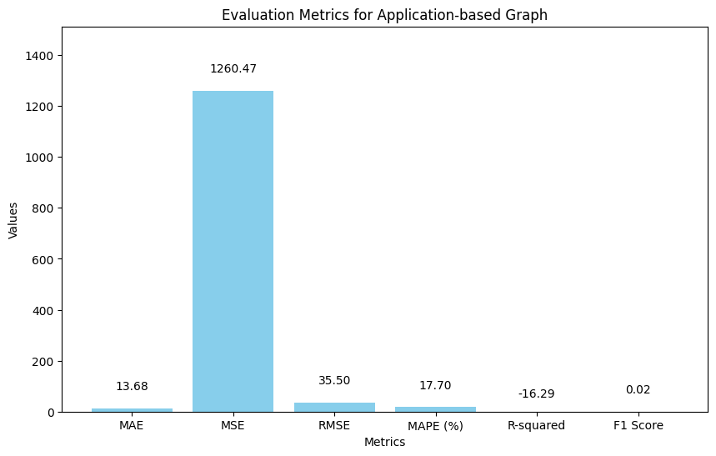
Comparison of Graph Result Analysis

Slide 28
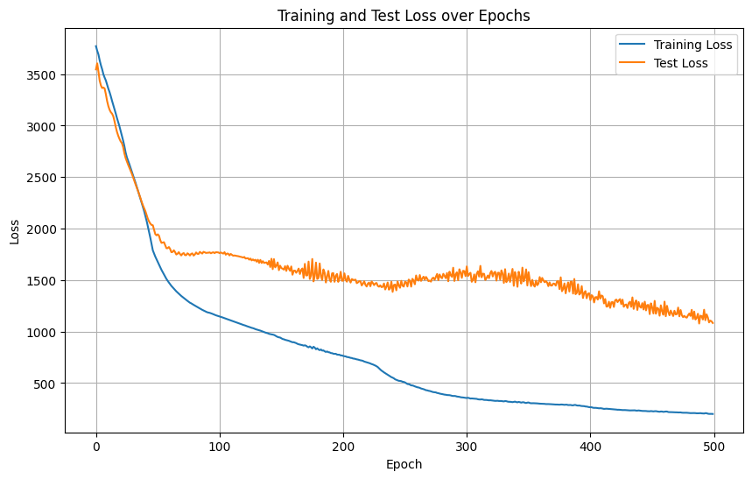
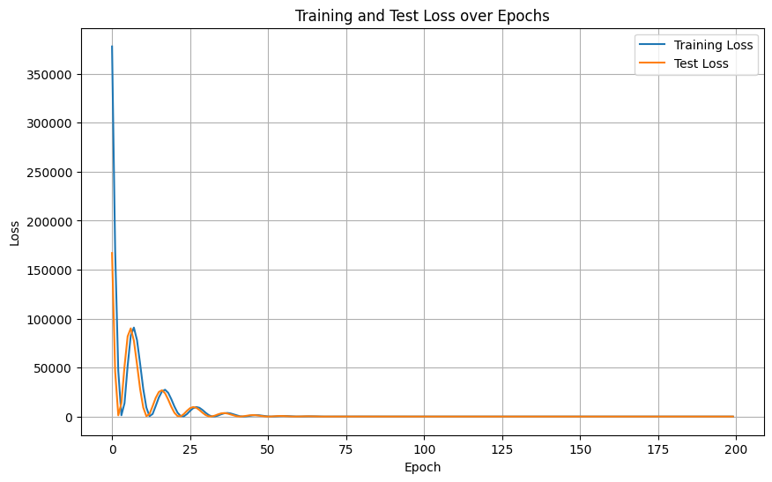
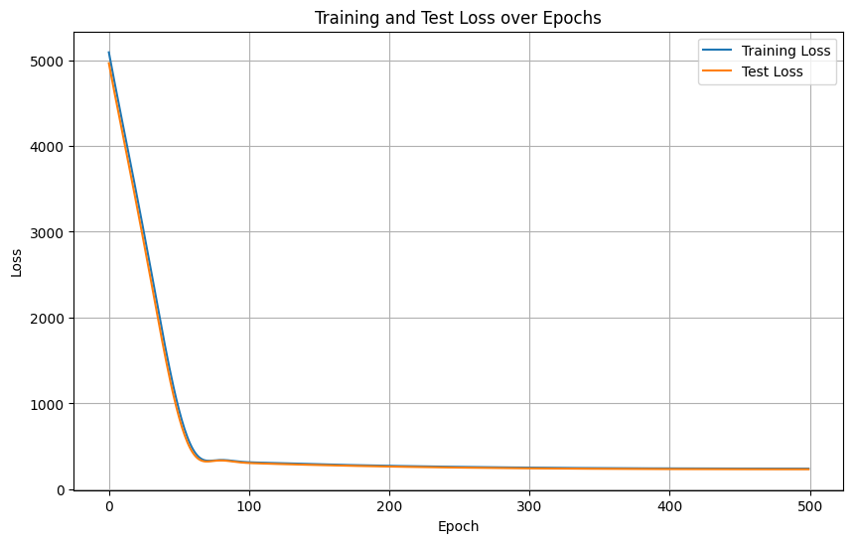
Comparison of Graph Result Analysis
Application based graph
Similarity based Graph
Spatial graph

Slide 29
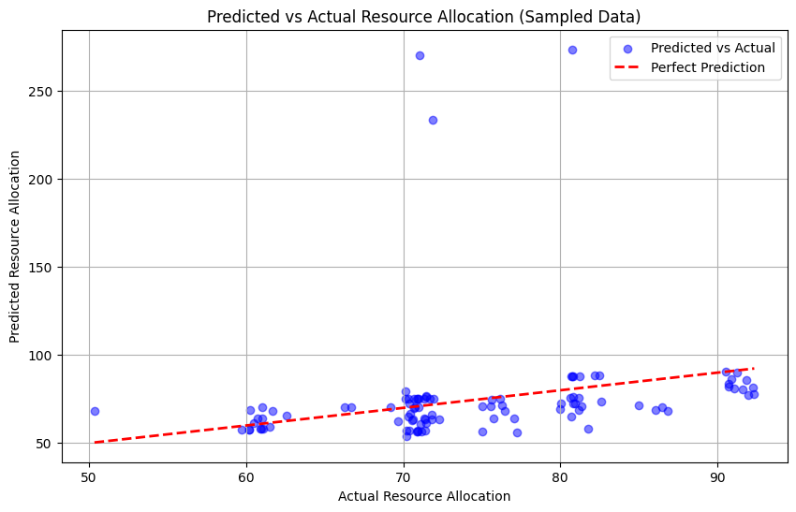
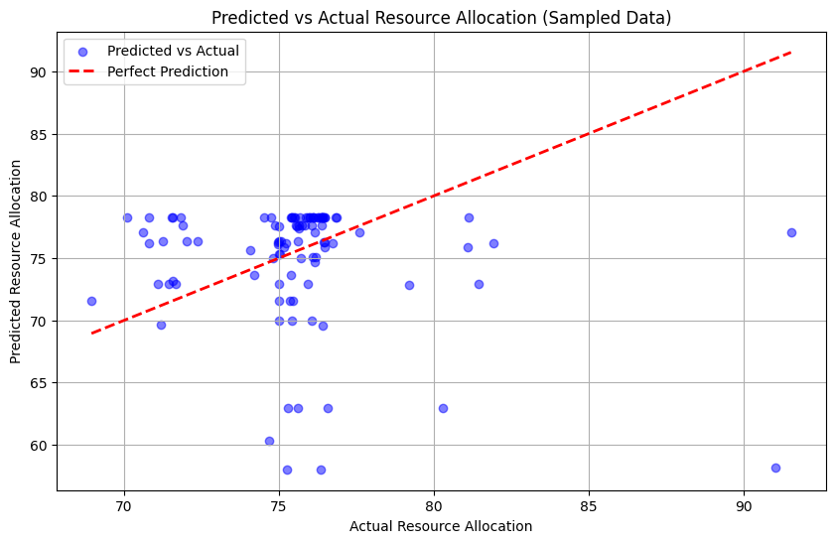
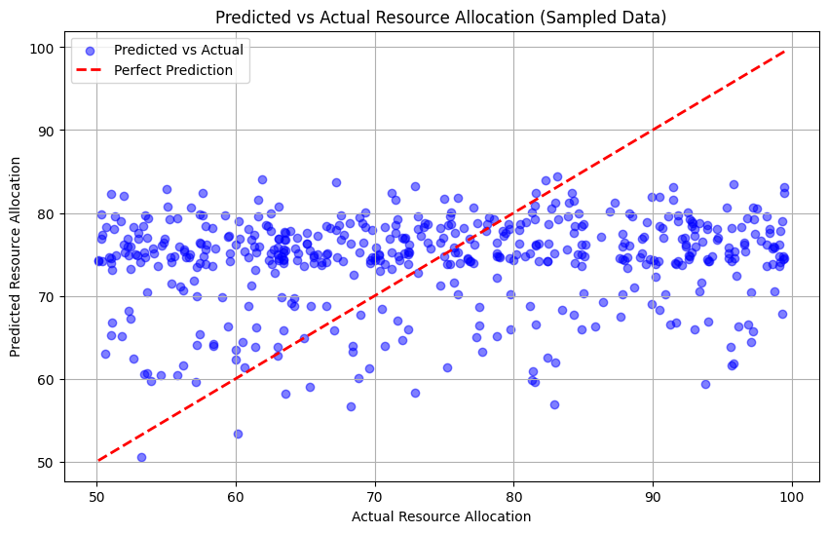
Comparison of Graph Result Analysis
Application based graph
Similarity based Graph
Spatial graph

Slide 30
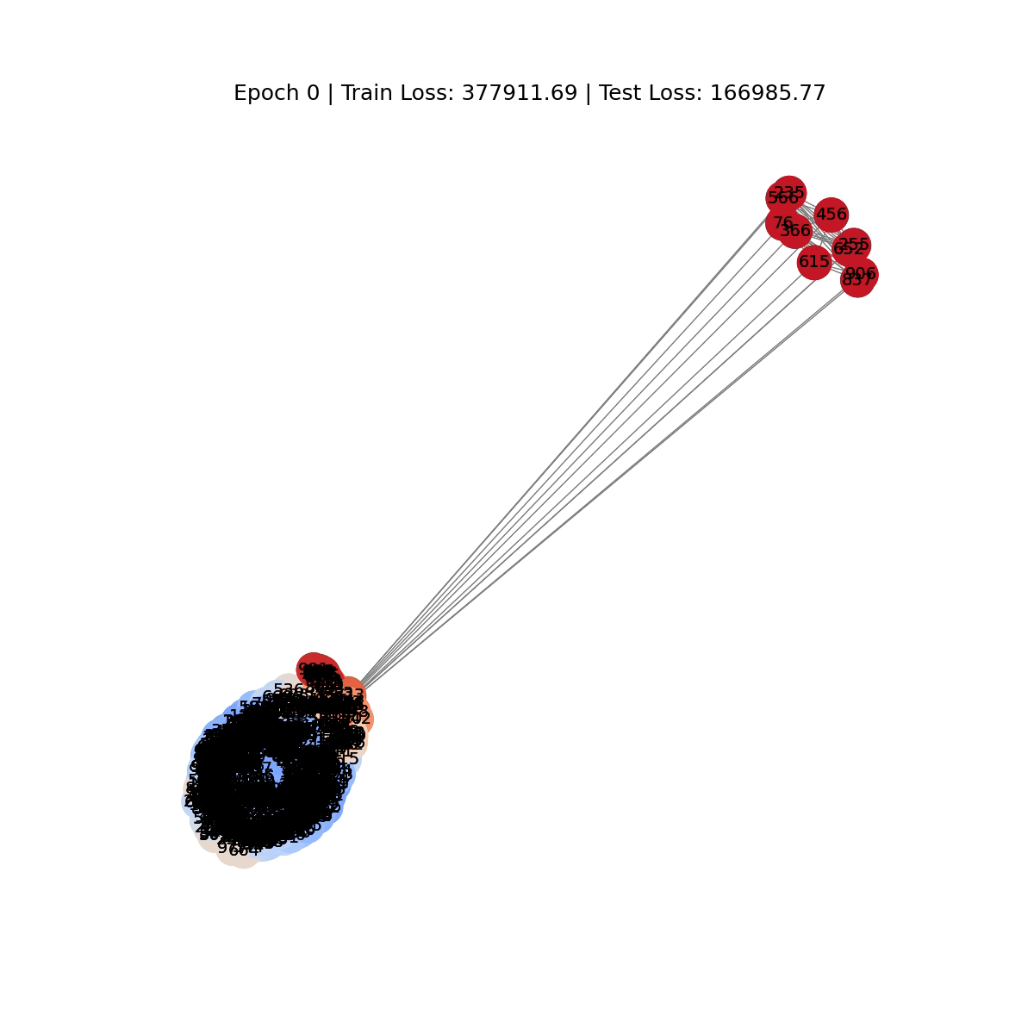
Comparison of Graph Result Analysis

Slide 31
Reinforcement Learning: -
Q-Learning:
Q-Learning works on discretized states, so the continuous feature values are discretized using distance based binning method.
The action spaces are increase, decrease or maintain allocated bandwidth based on the given instance state representation of feature.
Total States = Application Type*Signal Strength*Latency*Required Bandwidth*Allocated Bandwidth*Resource Allocation*Action Space
= 11*12*20*2000*2000*20*3
= 633,600,000,000

Slide 32
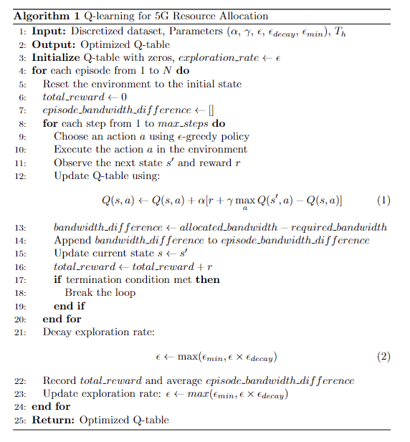
Reinforcement Learning: -

Slide 33
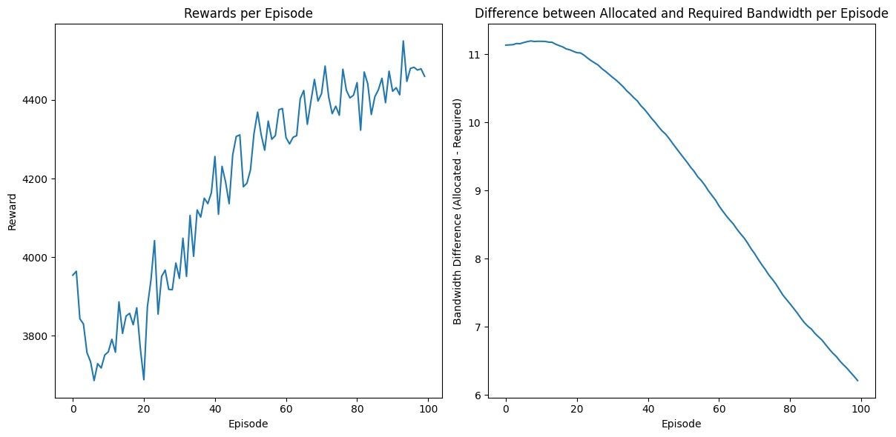
Reinforcement Learning: -
Q-Learning Result Analysis (for 100 episode)

Slide 34
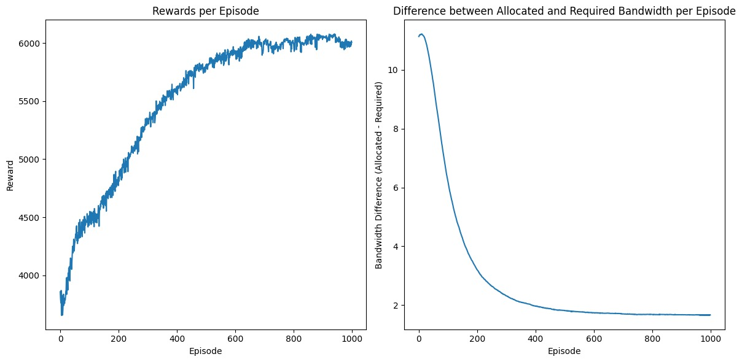
Reinforcement Learning: -
Q-Learning Result Analysis (for 1000 episode)
Inference:
The reward increases over the episodes, which states that model learns to make appropriate actions for the states.
Bandwidth difference decreases over episodes, which states that model actions optimizes the bandwidth.

Slide 35

Dynamic Data Generator: -
The dynamic data generator program uses MLP, where the MLP model is trained over the original dataset.
Based on the data in the original dataset the code modifies the feature values and MLP used to predict the data label.
The program dynamically generates data similar to original data in the dataset.

Slide 36
Requirements: -
Hardware Requirements
Processor: Intel i5 series
RAM: 8 GB
GPU: 4 GB
Software Requirements
Operating System: Windows 10, MacOS
Coding Language: Python, JavaScript
Packages: Keras, Torch, Matplotlib, TensorFlow, Random, Pandas, Scikit-learn, NumPy
IDE: Google Colaboratory, Visual Studio Code

Slide 37
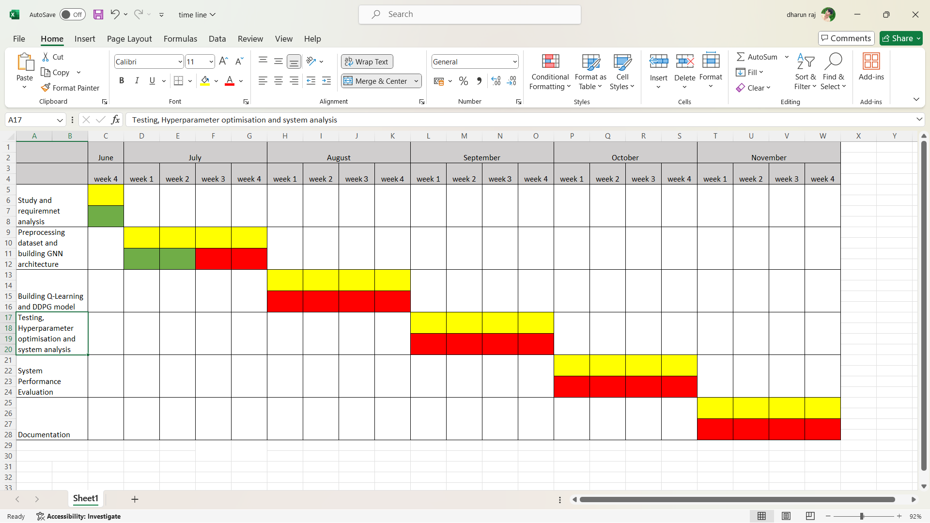
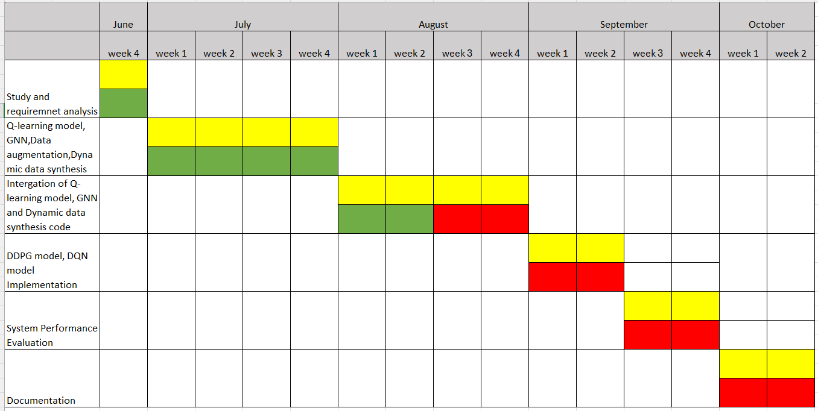
Timeline chart: -
Works Done
Works Assigned
Works to be done

Slide 38
References: -
Shi, Yi, Yalin E. Sagduyu, and Tugba Erpek. "Reinforcement learning for dynamic resource optimization in 5G radio access network slicing." 2020 IEEE 25th international workshop on computer aided modeling and design of communication links and networks (CAMAD). IEEE, 2020.
Jayaraman, Ramkumar, et al. "Effective resource allocation technique to improve QoS in 5G wireless network." Electronics 12.2 (2023): 451.
Chien, Wei-Che, et al. "Resource management in 5g mobile networks: Survey and challenges." Journal of Information Processing Systems 16.4 (2020): 896-914.
Agarwal, Bharat, et al. "A comprehensive survey on radio resource management in 5G HetNets: Current solutions, future trends and open issues." IEEE Communications Surveys & Tutorials 24.4 (2022): 2495-2534.
Abidi, Mustufa Haider, et al. Optimal 5G network slicing using machine learning and deep learning concepts. Computer Standards & Interfaces 76 (2021): 103518.

Slide 39
References: -
ΜΠΑΡΤΣΙΩΚΑΣ, Ιωάννης. ML-Based Radio Resource Management in 5G and Beyond Networks: A Survey (2023).
Kim, Yohan, Sunyong Kim, and Hyuk Lim.“Reinforcement learning based resource management for network slicing”. Applied Sciences 9.11(2019).
Guo, Hongzhi, et al. Multi-UAV cooperative task offloading and resource allocation in 5G advanced and beyond. IEEE Transactions on Wireless Communications 23.1(2023).
Saad, Wasan Kadhim, et al. “Handover and load balancing self-optimization models in 5G mobile networks”. EngineeringScience and Technology, an International Journal.(2023)
Logeshwaran, Jaganathan, et al. “Smart load-based resource optimization model to enhance the performance of device-to-device communication in 5G-WPAN”. Electronics 12.8 (2023)

Slide 40
THANK YOU!

Slide 41
Video_Call = 10000 kbps
Voice_Call = 100 kbps
Streaming = 5000 kbps
Emergency_Service = 1000 kbps
Online_Gaming = 2000 kbps
Background_Download = 500 kbps
.
Iot_Temperature = 10 kbps
Video_Streaming = 3200 kbps
File_Download = 2000 kbps
VoIP_Call = 150 kbps
Web_Browsing = 1000 kbps

